Slide 1

Gokaraju Rangaraju Institute of Engineering and Technology
(Autonomous)
Department of Data Science
Mini Project Work
(CSE(DS))
Review 1: Abstract Presentation
Batch No -10
Presented By:
1.Abhinav U (22241A6767)
2.Jasti Amit (22241A6793)
3.Medhansh K (22241A6799)
Under the Guidance of:
Dr. Mamidi Kiran Kumar
Associate Professor
Department of Data Science

Slide 2
SMART INVESTMENT PLANNING SYSTEM USING MACHINE LEARNING

Slide 3
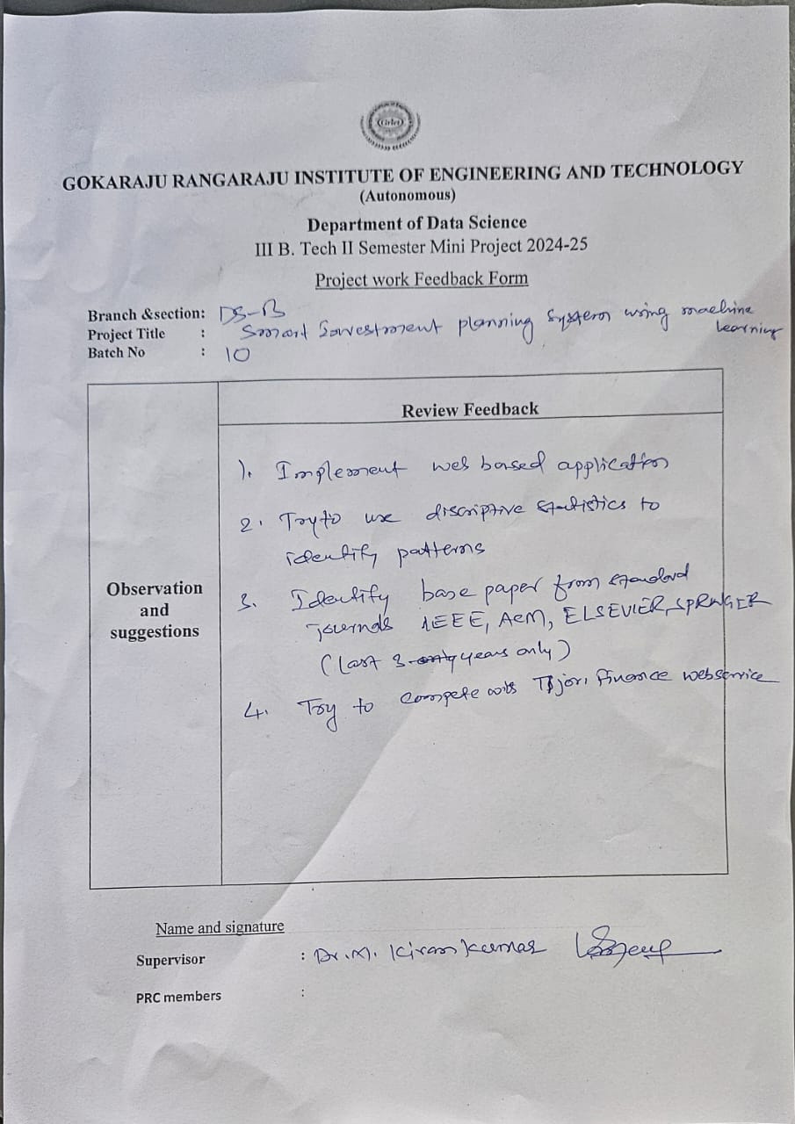
Feedback Form:

Slide 4

ABSTRACT
This project assists investors in making data-driven investment decisions by analyzing historical stock data from Alpha Vantage. It retrieves stock prices for selected companies and computes key financial metrics, including annualized returns, volatility, and the Sharpe ratio. Based on user inputs such as investment amount, duration (short-term or long-term), and risk tolerance, the system recommends a suitable company by filtering stocks according to risk-adjusted return metrics and estimating potential gains. Additionally, the project features a visualization component that plots historical stock prices, helping investors assess market trends. Alpha Vantage data includes historical and real-time stock prices, company fundamentals, financial statements, and valuation metrics, enabling informed investment decisions while considering market risks.

Slide 5
Problem Statement
Investors often struggle to identify the best stocks based on their investment capacity, risk tolerance, and investment duration. Additionally, real-time stock price fluctuations make decision-making challenging. A model that provides stock recommendations by analyzing these factors can help investors make informed choices.
Objectives
Personalized Stock Recommendation – Recommend the best stocks based on user-defined investment amount, risk factor, and duration.
Risk Assessment – Categorize stocks based on risk levels and align them with the investor’s risk tolerance.
Live Market Data Integration – Fetch real-time stock prices to ensure recommendations are based on the latest market trends.

Slide 6
MOTIVATION
Simplified Investment Decisions:
Many individual investors rely on intuition or limited information to make stock market decisions. This project aims to provide a systematic and data-driven approach using real-time stock data and risk-adjusted return metrics.
Risk-Aware Investment Selection:
Many investors struggle to balance returns and risk exposure. This project categorizes stocks into low, medium, and high-risk investments using statistical thresholds, making it easier to select stocks based on personal risk appetite.

Slide 7
Category
Paper 1
Paper 2
Predicting Stock Market Trends Using Machine Learning and Deep Learning Algorithms Via Continuous and Binary Data; Analysis
A Novel Integrated Approach for Stock Prediction Based on Modal Decomposition Technology and Machine Learning
Name
Stock Market Prediction & Forecasting (Kaggle)
Most Watched Stocks (2013-2023) (Kaggle)
Dataset
Methodologies
Decision Tree, Random Forest, Naive Bayes, K-Nearest Neighbors
LSTM (Long Short-Term Memory), CEEMDAN

Slide 8
Paper 1
Paper 2
Category
More Accurate
Enhanced predictive performance
Improved predictive performance
Effective noise reduction
Provides consistent performance
Advantages
High Cost
More Complexity
Computational Complexity
Limited pattern exploration
Disadvantages
Lack of integrating real-time data streams
Feature extraction and analysis might not be up to the mark
Research Gaps

Slide 9
Category
Paper 1
Paper 2
Mean Squared Error (MSE)
Mean Absolute Error (MAE) R-squared (R²)
RNN & LSTM achieved around 90% F1-score
RMSE, MAE used in the model
Prediction accuracy of over 67% for stocks
LSTM and RNN models improved accuracy
Accuracy & Measures

Slide 10
NOVELTY
Real-Time Data Integration:
The project leverages the Alpha Vantage API to fetch live and historical stock market data.
Unlike static datasets, which may become outdated, this approach ensures that users always receive the latest stock prices, trading volume, and historical trends.
Interactive Visualization:
The project generates time-series plots of stock prices, allowing users to visualize trends over different durations (1 year vs. 5 years).
The visual representation provides better insights than raw numerical data, making it easier for users—especially beginners—to interpret market trends.
Automated Filtering:
The model categorizes stocks into low, medium, and high-risk investments based on annualized volatility (a measure of price fluctuations).

Slide 11
DATA REQUIRED:
Stock Price Data (Time-Series Data):
The Opening Prices (Open) refer to the stock price at the start of the trading day, while the Closing Prices (Close) represent the final price at which the stock traded at the end of the day. Both are essential for calculating returns and analyzing trends throughout the trading period.
High & Low Prices (High, Low): The highest and lowest prices during a trading day, useful for volatility assessment
Calculated Data for Risk-Adjusted Analysis:
Daily Returns (percentage change in closing prices between consecutive days).
Annualized Return (average daily return multiplied by trading days in a year).
Annualized Volatility (standard deviation of daily returns, scaled for a year).

Slide 12
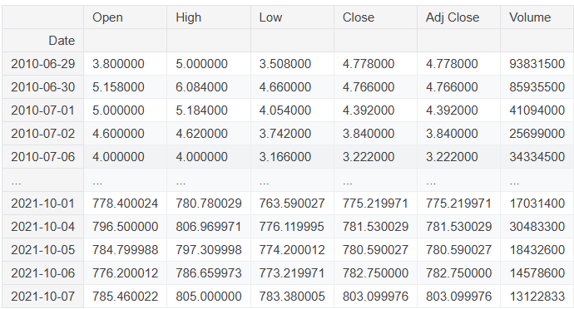
Sample Data
TRIDENT

Slide 13
METHODOLOGIES:
Data Collection:
Uses the Aplha Vantage API to fetch historical stock price data from Yahoo Finance.
Extracts relevant stock market indicators like closing prices and trading volume.
Stock Price Prediction using HHT:
The code applies Hilbert-Huang Transform (HHT) to break down stock price data into Intrinsic Mode Functions (IMFs).
Live Market Data Integration:
The model fetches real-time stock prices using the Alpha Vantage API.
Risk Assessment:
Stocks can be classified into low-risk, medium-risk, and high-risk based on historical volatility (variance in IMFs).

Slide 14
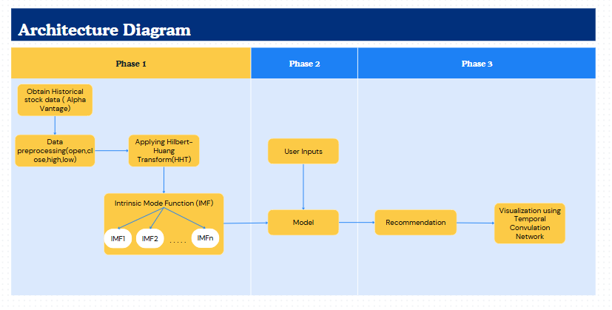
Architecture Diagram

Slide 15
Gokaraju Rangaraju Institute of Engineering and Technology
(Autonomous)
Department of Data Science
Mini Project Work
(CSE(DS))
Review 2: Architecture Desing Presentation
Batch No -10
Under the Guidance of:
Dr. Mamidi Kiran Kumar
Associate Professor
Department of Data Science
Presented By:
1.Abhinav U (22241A6767)
2.Jasti Amit (22241A6793)
3.Medhansh K (22241A6799)

Slide 16
SMART INVESTMENT PLANNING SYSTEM USING MACHINE LEARNING

Slide 17
Abstract
This project assists investors in making data-driven investment decisions by analyzing historical stock data from Alpha Vantage. It retrieves stock prices of the companies and computes key financial metrics, including annualized returns, volatility, and the Sharpe ratio. Based on user inputs such as investment amount, duration (short-term or long-term), and risk tolerance, the system recommends a suitable company by filtering stocks according to risk-adjusted return metrics and estimating potential gains. Additionally, the project features a visualization component that plots historical stock prices, helping investors assess market trends. Alpha Vanatage data includes historical and real-time stock prices, company fundamentals, financial statements, and valuation metrics, enabling informed investment decisions while considering market risks.

Slide 18
Literature Review

Slide 19
Category
Paper 1
Paper 2
Machine learning approaches in stock market prediction: A systematic literature review
Stock market prediction using machine learning: A study on the Indian stock market
Name
Source
ResearchGate
Springer
Analyze and predict the Indian stock market.
Review ML techniques in stock prediction.
Research Objective
Methodology
Reviewed 30 studies on ML models like SVM and Neural Networks.
Used historical stock data, financial news, and ML models like LSTM and SVM.
Key Findings
Neural networks are commonly used for stock prediction.
Social indicators improve stock market predictions.

Slide 20
Category
Paper 1
Paper 2
Neural Networks, SVM
LSTM, SVM, KNN, Random Forest
Techniques
Accuracy
84% trend prediction accuracy.
Achieved minimized RMSE error.
Provides a broad ML review for stock prediction.
Uses multiple data sources for better accuracy.
Advantages
No empirical performance data.
Disadvantages
Computationally expensive.

Slide 21
Category
Paper 3
Paper 4
A systematic review of stock market prediction using ML and statistical techniques
The Stock Exchange Prediction using ML Techniques: A Systematic Review
Name
Source
ResearchGate
ResearchGate
Identify research trends, datasets, and models in stock prediction.
Overview of ML and statistical techniques in stock prediction.
Research Objective
Methodology
Reviewed 30 papers covering ML and statistical techniques.
Analyzed 81 studies focusing on classification and estimation.
Key Findings
ANN and NN are widely used in prediction.
Classification and estimation are the most used methods.

Slide 22
Category
Paper 3
Paper 4
ANN, Statistical Methods
Classification, Estimation, Clustering
Techniques
Accuracy
75% trend prediction accuracy.
Approx 77% Accuracy
Highlights the power of ANN and NN.
Provides an in-depth trend analysis.
Advantages
Lacks performance comparison
No model performance evaluation.
Disadvantages

Slide 23
Category
Paper 5
Paper 6
Stock Market Prediction Using ML Techniques
Stock Market Prediction Using Advanced ML
Name
Source
ResearchGate
ResearchGate
Analyze stock data and predict future trends.
Predict stock trends using ML models.
Research Objective
Methodology
Compared models like LSTM, XGBoost, and ARIMA on Tesla stock.
Applied Linear Regression, Decision Trees, and SVM on historical data.
Key Findings
LSTM had the best prediction accuracy.
SVM performed better than other models.

Slide 24
Category
Paper 5
Paper 6
LSTM, XGBoost, ARIMA
Linear Regression, SVM, Decision Trees
Techniques
Accuracy
85% trend prediction accuracy.
Approx 79% Accuracy
Compares multiple ML models.
Proves ML effectiveness in finance.
Advantages
Dataset limitations affect generalization.
High computational cost.
Disadvantages

Slide 25
Category
Paper 7
Paper 8
A Survey of ML-Based Approaches for Stock Market Prediction
Stock Market Prediction using ML Algorithm
Name
Source
Springer
ResearchGate
Predict stock market trends using ML models.
Review ML techniques for stock forecasting.
Research Objective
Methodology
Compared various ML methods for stock forecasting.
Used LSTM on historical stock data for trend prediction.
Key Findings
Deep learning models show high predictive power.
LSTM achieved 84% accuracy in trend forecasting.

Slide 26
Category
Paper 7
Paper 8
Various ML Models
LSTM, RNN
Techniques
Accuracy
~80% trend prediction accuracy.
Approx 84% Accuracy
Comprehensive review of ML in stock forecasting.
Shows LSTM’s ability to capture trends.
Advantages
Focuses only on LSTM, limiting comparison
No empirical performance data.
Disadvantages

Slide 27
Category
Paper 9
Paper 10
Deep Learning for Stock Market Prediction
A Deep Learning-Based Approach for Stock Market Prediction
Name
Source
IEEE Xplore
arXiv
To predict future values of stock market groups using deep learning
Explore deep learning for stock forecasting.
Research Objective
Methodology
Applied CNN-LSTM hybrid models on historical data.
Used LSTM on historical stock data for trend prediction.
Key Findings
CNN-LSTM outperformed traditional ML models.
LSTM achieved 84% accuracy in trend forecasting.

Slide 28
Category
Paper 9
Paper 10
CNN, LSTM, Hybrid Deep Learning Models
Techniques
LSTM, RNN, ANN, Decision Tree,
Accuracy
~87% trend prediction accuracy.
Approx 89% Accuracy
Deep learning models outperform traditional methods.
Comprehensive evaluation of multiple machine learning and deep learning models on diverse stock groups.
Advantages
High computational cost for training.
Lack of specific performance metrics and potential overfitting due to model complexity.
Disadvantages

Slide 29
Research Gaps
1. Dependence on Historical Data:
Some models primarily rely on past data, which may not accurately reflect sudden market shifts.
They fail to capture real-time economic events, geopolitical risks, or market sentiment changes.
2. Lack of Real-Time Market Integration:
Certain models do not incorporate real-time price movements and news updates.
They may lag behind current trends, leading to delayed or inaccurate predictions.
3. Focus on Short-Term Predictions:
Some approaches are optimized for short-term trading rather than long-term investment strategies.
They may not account for macroeconomic trends, fundamental analysis, or long-term portfolio growth.

Slide 30
Problem Statement
Investors often face challenges in selecting the best stocks based on their investment capacity, risk tolerance, and investment duration. Additionally, the high volatility of stock prices and real-time market fluctuations make it difficult to make informed decisions. Traditional forecasting methods may not effectively capture the nonlinear and non-stationary nature of stock price movements, leading to inaccurate predictions.To address this challenge, Hilbert-Huang Transform (HHT) and Temporal Convolutional Network (TCN)-based stock prediction model is developed. The model first decomposes stock price trends using EMD to extract relevant features, helping to capture underlying patterns in the data. It then leverages TCN to learn historical price patterns and predict future stock prices with improved accuracy.

Slide 31
Objectives
Live Market Data Integration – Fetch real-time stock prices to ensure recommendations are based on the latest market trends.
Extracting the Intrinsic Mode function using the Hilbert-Huang Transform (HTT) and advanced algorihtms.
Forecasting the trends using the advanced techniques like Temporal convulation Network
Risk Assessment – Categorize stocks based on risk levels and align them with the investor’s risk tolerance.

Slide 32
Architecture Diagram
Training
Model

Slide 33
Hardware and Software Requirements
Hardware Requirements
Software Requirements
Operating System:
Windows 10/11 (64-bit)
macOS (10.15 Catalina or later)
Linux (Ubuntu 18.04 or later)
Processor (CPU): Intel Core i5 (or equivalent) and above (Recommended: Intel Core i7 or AMD Ryzen 5 and above)
Memory (RAM): Minimum 8GB (Recommended: 16GB or higher for better performance)
Python Version: Python 3.7 or later
Storage: Minimum 10GB free space (Recommended: SSD for faster performance)
Required Python Libraries

Slide 34
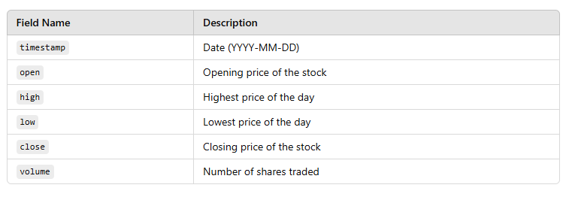
Dataset Details
Dataset Link:https://www.alphavantage.co/documentation/
Dataset Fields:
Dataset Size: 15774 Instances

Slide 35
References
Said Achmad , Machine Learning Approaches in Stock Market Prediction: A Systematic Literature Review
N. D. Parikh et al. , Stock Market Prediction Using Machine Learning: A Study on the Indian Market
Deepak Kumar , A Systematic Review of Stock Market Prediction Using Machine Learning and Statistical Techniques
Arif Djunaidy & Rico Bayu Wiranata, The Stock Exchange Prediction Using Machine Learning Techniques: A Comprehensive and Systematic Literature Review
Veronica E. Medina & Priya Dua , Stock Market Prediction Using Machine Learning Techniques
R. D. R. N. S. Abhishek et al. , Predicting Stock Price Movements with Neural Networks

Slide 36
References
Srinivasan, M., & Mishra, A. , Stock Market Forecasting Using LSTM Neural Network
AuSubha, A., et al. , A Hybrid Machine Learning Framework for Stock Market Prediction
N. D. Parikh et al. , Financial Time Series Prediction Using a Convolutional Neural Network
P. K. Pati et al. , Deep Learning for Stock Market Prediction

Slide 37

Thank You

